Slide 1
Tools for Data Manipulation & Management
Jeremy Bergmann - Omaha Data Science Academy

Slide 2
Review: Class 6
Purpose of Database Modeling
Entity-Relationship Diagrams
Relational Database Modeling
Normal Forms: 1NF, 2NF, 3NF
Dimensional Data Modeling: Kimball
Database Modeling using Data.io
Notes:
Feynman technique: Learn -> Explain -> Reflect -> Repeat
What are the most important ideas from last class? Write a summary of the information as if explaining to a 14 year old. Avoid jargon Keep the words and sentences simple Rely on memory Make the explanation visual, if possible Note where you had difficulty or have knowledge gaps. These indicate things you should review, research, or ask questions about

Slide 3
Class 7 Objectives
ETL & Workflow Tools: Talend, Python, Dataiku
Cloud Storage: Google Cloud, AWS, Microsoft
NoSql Introduction
Exercises – Google Cloud Products, Dataiku
Notes:
Feynman technique: Learn -> Explain -> Reflect -> Repeat
What are the most important ideas from last class? Write a summary of the information as if explaining to a 14 year old. Avoid jargon Keep the words and sentences simple Rely on memory Make the explanation visual, if possible Note where you had difficulty or have knowledge gaps. These indicate things you should review, research, or ask questions about

Slide 4
Review
It is important to…
know the tool space for doing particular kind of work (like storing and manipulating data)
What are the latest tools?
What are the most popular tools among individuals/companies?
know the degree to which knowing one tool well qualifies you to work with similar tools
be comfortable finding and reading documentation
Notes:
Feynman technique: Learn -> Explain -> Reflect -> Repeat
What are the most important ideas from last class? Write a summary of the information as if explaining to a 14 year old. Avoid jargon Keep the words and sentences simple Rely on memory Make the explanation visual, if possible Note where you had difficulty or have knowledge gaps. These indicate things you should review, research, or ask questions about

Slide 5
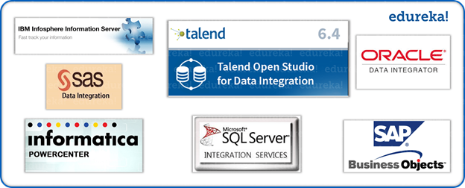
Examples of ETL Tools
There are several ETL tools available today. Many are integrated with larger Business Intelligence (BI) or Analytics platforms, while some are open source. Here are some options:
Oracle Warehouse Builder (OWB)
SAP Data Services
SAS Data Management
PowerCenter Informatica
SQL Server Integration Services (SSIS)
Talend Studio
Additionally, You can create flexible ETL & Data Quality processes using Python, using supporting libraries
bonobo: https://www.bonobo-project.org/
Python-ETL: https://pypi.org/project/Python-ETL/
pygrametl: http://chrthomsen.github.io/pygrametl/
bubbles: http://bubbles.databrewery.org/
awesome-etl: https://github.com/pawl/awesome-etl
pymysql: https://github.com/PyMySQL/PyMySQL

Slide 6

What is Talend?
Talend is becoming one of the leaders in desktop and cloud data integration. It’s an ETL tool that has many options for database, cloud, and Big Data integrations. Talend does offer commercial products, but there is a fully functional, free, open source option.
Some of the advantages of using an ETL tool like Talend are:
It lessens the need for writing procedures and code, since there’s an interactive GUI
This provides a visual flow of the ETL process and system logic
There are advanced tools built to do routine procedures, like cleaning data, sorting, joining, merging, and other manipulation processes
It has many integrations that support systems that are databases, cloud based software, and many file formats.

Slide 7
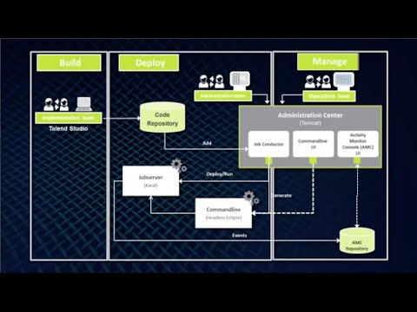
Demo - Talend Studio
Tutorials: https://community.talend.com/t5/custom/page/page-id/Tutorials

Slide 8
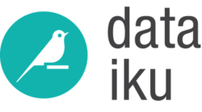
Workflow Tools: Dataiku
Steps to Engineering a Dataiku Workflow:
Create a new project
Connect to and/or Import Dataset(s)
Visual Prep - Data “Recipes”
Code Transformation(s) - Python
Visual Analysis, Data Prep & ML (The Lab)
Data Product Development
Reports, Dashboards, Insights, WebApps
Job, Workflow & Scenario Scheduling
Workflow Monitoring & Maintenance
Documentation - Wiki & Juypter Notebooks
Dataiku DSS “Bring data analysts, engineers, and scientists together”, “Enables self-service analytics” and “operationalizes machine learning” ts today and build for tomorrow.
Notes:
The Lab is a place for drafting your work, whether it is preliminary data exploration and cleansing or machine learning models creation. The Lab environment contains:
the Visual Analysis tool to let you draft data preparation, charts, and machine learning models
the Code Notebooks to let you explore your data interactively in the language of your choice
Note that some tasks can be performed both in the lab environment and using recipes in the flow. Here are

Slide 9
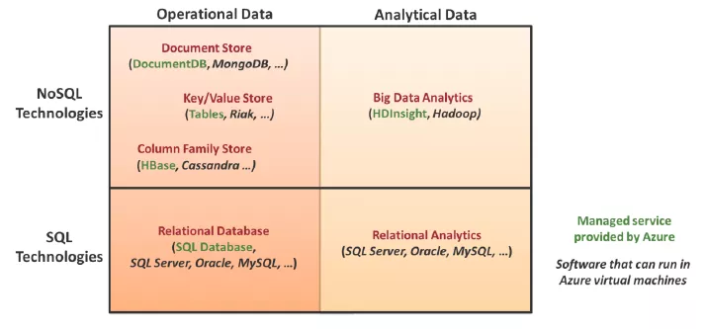
What is NoSQL?
NoSQL is a way of saying “non-relational” or an alternative to more traditional relational databases. These database systems are not built on tables and do not need SQL language to be used to manipulate data. NoSQL databases can also handle semi-structured and unstructured data, which is essential in Data Science.
What are Some Examples
of NoSQL Databases?
MongoDB - Open Source
Apache Cassandra - Open Source
Couchbase - Open Source
MS Azure Cosmos DB
Amazon DynamoDB
Google Cloud Platform
Cloud Datastore
Cloud Bigtable
Notes:
Relationship: OLTP = Source for OLAP

Slide 10
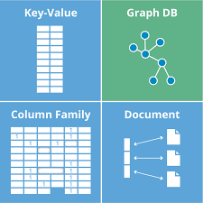
NoSQL Database Types
There are four main database types supported by NoSQL systems:
Document Databases pair each key with a complex data structure known as a document. Documents can contain many different key-value pairs, or key-array pairs, or even nested documents.
Graph Stores are used to store information about networks of data, such as social connections.
Key-value Stores are the simplest NoSQL databases. Every item in the database is stored as an attribute name (or 'key'), together with its value. Some key-value stores allow each value to have a type, such as 'integer', which adds functionality.
Wide-column Stores are optimized for queries over large datasets, and store columns of data together, instead of rows.
Notes:
Relationship: OLTP = Source for OLAP

Slide 11
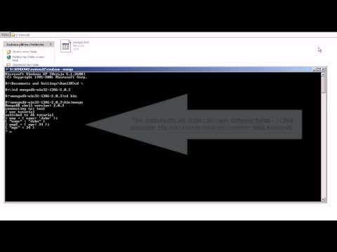
NoSQL Demo
Notes:
Relationship: OLTP = Source for OLAP

Slide 12
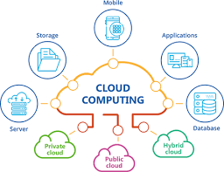
Why is Cloud Computing So Important for Businesses?
Cloud computing lets companies focus on running their infrastructure instead of housing expensive internal servers and employing a team of System Administrators. With cloud services, businesses can spool up and manage their own servers on-demand.
Cloud services rely on shared resources, which means Amazon, Google and Microsoft supply servers in different data centers. This greatly lowers overhead in maintaining a system and increases flexibility in scaling system up and down as needed.
Notes:
Amazon, Microsoft, and Google developed their own cloud services to be used internally. Amazon originally created AWS as their internal compute, storage, database, and migration systems. The same goes for Google and Google Cloud Platform, and Microsoft and Azure. Spotify, Netflix, the Google Search Engine, YouTube, all Microsoft programs, and the Amazon Store all use one of these three cloud platforms.

Slide 13
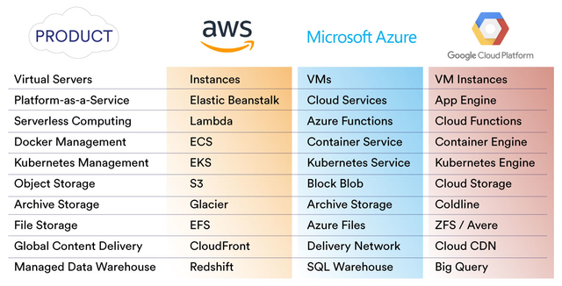
AWS Vs Google Cloud Platform Vs Azure
Amazon Web Services (AWS) AWS has an extensive list of computing services with functions of deployment, mobile networking, and others.
Google Cloud Platform (GCP) Created to strengthen their own services, but extended via the creation of enterprise services.
GCP separates itself by donating much of its resources to the development of Big Data products.
Microsoft Azure This platform can easily be associated with AWS – both of them provide their customers with a full set of cloud services.
Notes:
Relationship: OLTP = Source for OLAP

Slide 14
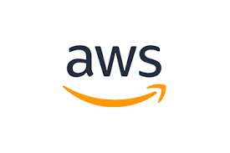
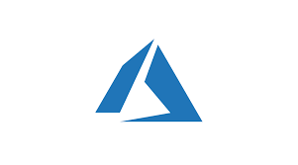

Database Comparison
Amazon’s RDS (Relational Database Service) provides support for major databases including Oracle, PostgreSQL and MySQL.
Azure SQL & Cloud SQL offers SQL database handling features for Azure and GCP respectively.
All three offer high-performance NoSQL DB choices such as DocumentDB for Azure, Aurora for AWS & Datastore & BigTable for Google Cloud.
Notes:
Relat

Slide 15
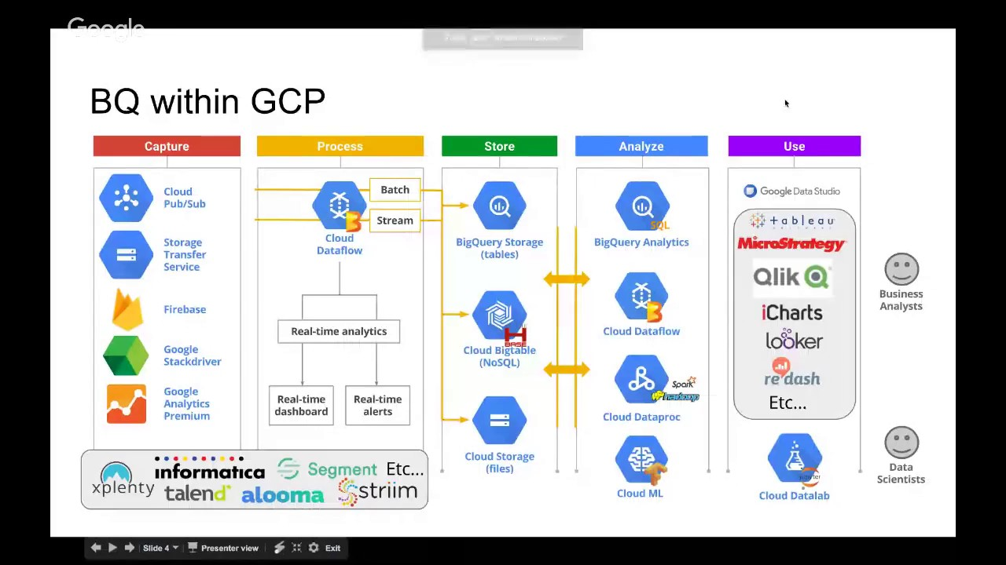
Google Cloud Big Data Solutions
Notes:
BigQuery is Google's serverless data warehouse that scales with storage and computing power needs. BigQuery lets you get a columnar and ANSI SQL database that can analyze petabytes of data.
Cloud Dataflow is for batch and stream data processing. is a service for transforming and enriching data in stream (real time) and batch (historical) modes.
Cloud Dataproc is managed cloud service for running Apache Spark and Apache Hadoop. Cloud Dataproc integrates with storage, compute, and monitoring services across Google Cloud products, so you can build a data processing platform.
Cloud Dataprep is for data preparation and let you explore, clean, and prepare structured and unstructured data for analysis.
Cloud Pub/Sub is for event ingestion and messaging that you can scale. It’s Google’s main building block for stream analytics and event-driven computing services.
Cloud Bigtable is a managed NoSQL database service. It lets you scale a NoSQL database for low-latency and high-throughput workloads. Bigtable integrates with tools like Hadoop and Spark.
Google Cloud Storage is meant to be Google’s solution for object storage for big data. You can use it to serve website content, store data for archival and disaster recovery, and distribute large data objects to other people by direct download.

Slide 16
Google Cloud - Enterprise Services
PRODUCT | DESCRIPTION | GOOD FOR
Cloud Storage | A scalable, fully managed, highly reliable, and cost-efficient object / blob store. | Images, pictures, and videos Objects and blobs, Unstructured data
Cloud Bigtable | A scalable, fully managed NoSQL wide-column database that is suitable for both low-latency single-point lookups and precalculated analytics. | Low-latency read/write access High-throughput data processing, Time series support
Cloud Datastore | A scalable, fully managed NoSQL document database for your web and mobile applications. | Semistructured application data Hierarchical data, Durable key-value data
Cloud SQL | A fully managed MySQL and PostgreSQL database service that is built on the strength and reliability of Google's infrastructure. | Web frameworks, Structured data, OLTP workloads
Cloud Spanner | Mission-critical, relational database service with transactional consistency, global scale, and high availability. | Mission-critical applications High transactions, Scale + consistency requirements
BigQuery | A scalable, fully managed enterprise data warehouse (EDW) with SQL and fast ad-hoc queries. | OLAP workloads up to petabyte scale Big data exploration and processing, (BI) tools
Drive Enterprise | A collaborative space for storing, sharing, and editing files. | End-user interaction with docs and files Collaborative creation and editing, Syncing files
Notes:
Relationship: OLTP = Source for OLAP

Slide 17
Google Cloud ML & AI Solutions
Google Cloud Machine Learning (ML) Engine is a service that lets developers and data scientists build and bring machine learning models to production. Cloud ML Engine offers training and prediction services, which can be used together or individually. A few examples of how Cloud ML Engine is used to solve problems are: identifying clouds in satellite images, ensuring food safety, and responding four times faster to customer emails. This product is also referred to as “Cloud ML Engine”. You can integrate it with other GCP products like Cloud Storage, Cloud Dataflow, and Cloud Datalab to build models.
Google also supports many open source products, like scikit-learn, XGBoost, Keras, and TensorFlow, which you all can use on top of ML Engine.
BigQuery ML lets data scientists build ML models on structured or semi-structured data inside BigQuery. This option allows you to use SQL as a way to query data.
Other AI and ML Offerings:
Cloud Text-to-Speech gives developers the ability to synthesize natural speech.
Cloud Natural Language is a way to extract information from text.
Cloud Translation lets you translate between dozens of languages.
Cloud Datalab is Google’s version of a hosted Jupyter Notebook. With this you can share and test code.
Notes:
Relationship: OLTP = Source for OLAP

Slide 18
Project - Using Google Data Studio
Step 1) Create a google account, then connect to the following URL:
https://datastudio.google.com/data?search=mysql
Step 2) Create a SQL dump file of your local MySQL database
cmd line: cd C:\Program Files\MySQL\MySQL Workbench 8.0 CE
mysqldump -u root -p world > “C:\Data Manipulation\sql_world_dump.sql”
Step 3) Create a Cloud Storage bucket
Step 4) Upload SQL dump file to Cloud Storage bucket
Step 5) Go to the Cloud SQL Instances page in GCP
Use “Cloud SQL Instance Page” on link below
Select “Create Instance”
Select “MySQL”
Steps at: https://cloud.google.com/sql/docs/mysql/import-export/importing
Step 6) Fill-in the “Create a MySql Second Generation instance”
Instance ID: (database name)
Select “No Password”
Select “Create”
Step 7) “SQL Instances” should now appear - select the instance from 6)
Step 8) Click Import in the button bar.
Enter the path to the bucket and SQL dump file you uploaded
Format of import - “SQL”
Select Database - “mysql
Step 9) Navigate bace to Google Data Studio → Connect to Data
Select “Cloud SQL for MySQL” connector “ - “Create Datasource
Authorize connection
Provide Instance Connection Name/Database/Username & Pass
Step 10) Create using MySQL cloud datasource in Google
Notes:
Relationship: OLTP = Source for OLAP

Slide 19
IBM Cloud Solutions
Other Relational Databases
The Big 9 - Suggested Reading

